Slide 1
JIBEBE MECHANICAL TEAM WEEK 3
Catherine kipkazi

Slide 2
TASKS COMPLETED
Fabrication of motor mount
Fabrication of electric fan mount
Completion of final design work of battery mount

Slide 3
MATERIAL ACQUISITION
We were able to acquire some materials to kickstart the fabrication process eg
Consumables
Angle lines
Plates

Slide 4
FABRICATION
We began the fabrication of the motor mount.

Slide 5
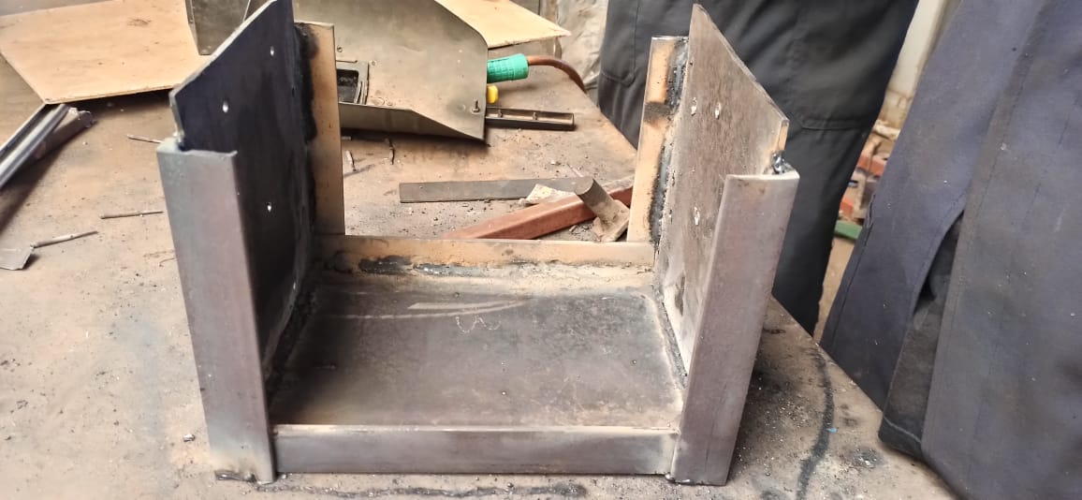
M

Slide 6
TASKS THIS WEEK
Acquisition of materials
Installation of motor mount
Fabrication of battery mount
Design of flywheel-clutch coupling

